Slide 1
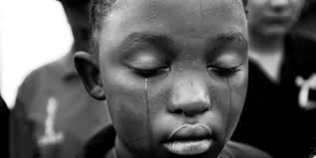
Child Abuse & Neglect
Dr. Beatrice C. Mutai
MBChB, MMed (Paeds & Child Health)

Slide 2
Objectives
Definitions
Epidemiology
Risk factors
Classification, recognition, diagnosis & treatment
Physical abuse
Sexual abuse
Unusual manifestations of child abuse
Munchausen syndrome
Child neglect & abandonment
Non-organic failure to thrive
Prevention

Slide 3
CHILD ABUSE
PHYSICAL ABUSE
SEXUAL ABUSE
EMOTIONAL ABUSE
NEGLECT AND ABANDONMENT
Actions of inflicting/permitting infliction of physical or mental harm on a child by a person who is responsible for that child¹.
Actions may or may not result is actual harm to the child.
Intentional harm/threat of harm to a child by someone acting in the role of caretaker, for even a short time²
WHO Report on the Consultation on Child Abuse Prevention Geneva, March 29-31, 1999
Lawrence S et al. Child Abuse & Neglect: Current Concepts. NEJM, Vol 332, No 21.

Slide 4
Global epidemiology of Child Abuse
2017 WHO global estimates:
1 billion children (ages 2 - 17 years) suffered either physical, emotional, or sexual abuse
Perpetrators were mainly parents, relatives, spouses of child brides and teachers.
Most common form of abuse was child neglect
Higher occurrence of neglect & physical abuse in low socio-economic class
Sexual abuse is consistent across income groups
Child abuse often associated with other forms of intra-familial violence
(spousal battering, violence between siblings)

Slide 5
Global epidemiology of Child Abuse
United States
2-3% of children (< 18 years) abused each year
1000-2000 children die each year from abuse (80% aged < 5 years, 40% aged < 1 year)
Physical & emotional abuse increases with age.

Slide 6
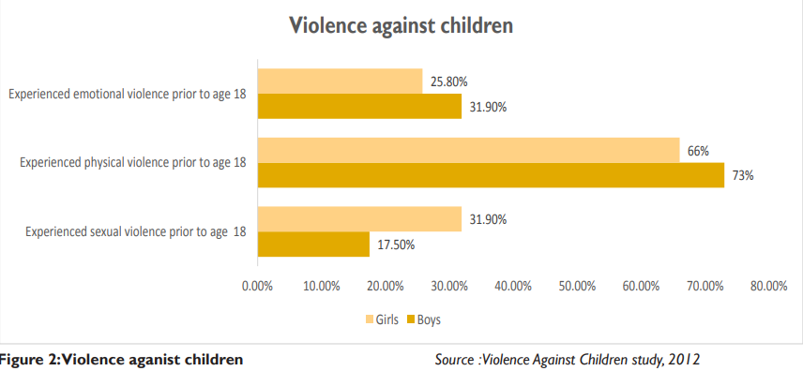
Status on child abuse in Kenya

Slide 7
Effect of abuse on child health
Threat to child survival & development
Fatal/non-fatal physical injuries
Other health problems (failure to thrive, lung, heart & liver diseases)
Cognitive impairment (impaired school & work performance)
Psychological & emotional problems (feelings of rejection, impaired attachment, fear, anxiety, insecurity & shattered self-esteem)

Slide 8
Effect of abuse on child health
Mental health problems (anxiety & depression, hallucinations, memory disturbances & suicidal ideation)
Engagement in risky behaviours (substance abuse & early initiation of sexual activity)
Developmental & behaviour problems (non-attendance at school, antisocial & destructive behaviour, poor relationships, school exclusion & conflict with the law)

Slide 9
Risk factors for child abuse
Families/parents at risk:
Low socio-economic status
Young parents/teenage mothers
Single self supporting parent
Mother with psychiatric illness
Maternal illness (chronic)
Parental drug dependence/substance abuse
Parents who were abused or were in institutional care as children

Slide 10
Risk factors for child abuse
Children at risk:
Young age (< 3 years)
Step/ foster children
Premature babies
One of twins/failed expectations of the child
Child with mental/physical defect

Slide 11
Physical child abuse:
Definition: Intentional use of excessive physical force on a child that results in harm to the child's health & development.
Includes acts of:
- hitting, beating, kicking, shaking, biting, strangling, scalding,
burning, poisoning and suffocating
or
- forcing a child to engage in physically harmful activities e.g strenuous
exercise
Result in: bruising, breach of the skin, burns or disruption of a function, irrespective of intent or justification.
(physical violence is often inflicted with the object of punishing)

Slide 12
Physical child abuse:
Note: includes-
Any physical punishment inflicted on:
a child below the age of 1 year or
on a child with physical or mental disability
Definition provides acceptable limits for physical punishment at home and corporal punishment at school.
Incidents should be reported to induce perpetrators to learn more acceptable alternative methods of discipline.

Slide 13
Physical abuse: Recognition
HISTORY:
High index of suspicion if:
Infants/pre-school children: (60-70% of cases aged <3 years) –
Especially if: -aggressive/withdrawn, chronically ill
-born out of unwanted pregnancy to a single mother
(defenceless, extremely demanding of parents/guardians, unable to express wishes/fears)
Children presenting with injuries & suggestive history:
No/inadequate explanations of the injuries (just occurred, child injured themselves)
Delay in seeking medical care
Different explanations by different people
Recurrent injuries in the same child or similar injuries in siblings

Slide 14
Physical abuse: Recognition
PHYSICAL EXAMINATION:
May present as bruises, cuts, ecchymoses, burns, lacerations, fractures and bites with following characteristics:
Multiple, at different sites, different stages of healing
Bruises indicating imprints of well known objects:
Well-demarcated cigarette burns
Whip marks of a belt buckle
Unusual sites: Black eyes (especially if bilateral); on the legs of a child who is not yet walking; on the face & neck; over the back, private parts; buttocks.
Burns presenting as glove & stocking scalds to the hands and feet

Slide 15
Physical abuse: Recognition
PHYSICAL EXAMINATION:
Other suggestive physical findings:
Sub-conjunctival, anterior chamber and retinal haemorrhages
Unexplained impaired level of consciousness
Ruptured abdominal viscus with inadequate explanation
Characteristic fractures: Multiple or unusual (spiral fractures, diaphyseal fractures)
Presence of other signs of abuse: neglect, inorganic failure to thrive, sexual abuse

Slide 16
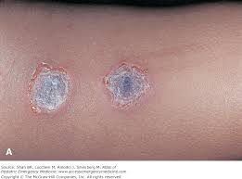
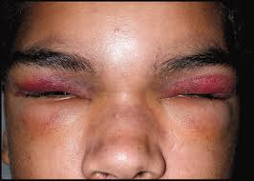
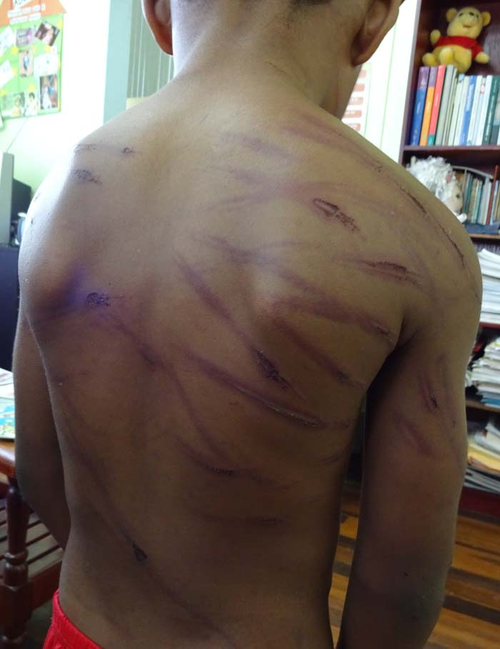
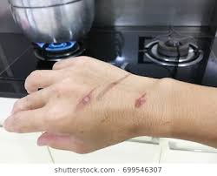
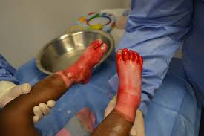
Physical Abuse: Recognition

Slide 17
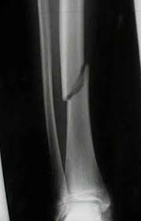
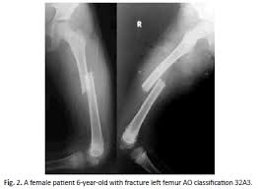
Physical abuse: Suggestive Fractures

Slide 18
Physical abuse: Syndromes
Battered baby syndrome
Terminology by Dr. Henry Kempe in 1961
Age < 3 years
Due to multiple episodes of trauma (beating & neglect)
Presentation:
subdural hematoma,
fractures & bruises in various stages of healing
In addition present with chronic malnutrition
Shaken baby syndrome
Age < 2 years
Due to violent shaking of the baby held by the torso
Presentation:
whiplash injury to head, neck and limbs
acute brain injuries (cerebral contusions, sub-dural/sub-arachnoid hemorrhages)
Diaphyseal long bone fractures, cervical spinal cord injuries
No discernable evidence of blunt head trauma

Slide 19
Physical abuse: Approach to history taking & physical examination
History
Examination
Detailed history should be obtained as follows:
Complete description of injury:
(when, where, how, who was present, time elapsed between injury and presentation)
Child’s age & developmental stage
Current health status
Past history of injuries
Detailed social history:
(Family structure, socio-economic status )
Thorough physical examination:
Describe injuries:
(size, shape, colour, position on the body, type of lesion).
Child’s general appearance, mood & affect.
Interaction between child & parent
Document anthropometric measurements
Look for other signs of abuse

Slide 20
Physical abuse: Approach to history taking & physical examination
Take history away from the suspected battering individual if child is old enough
Obtain additional history from neighbours (child heard crying on several occasions, is parent/guardian is alcoholic, psychiatrically sick)
Take photos of the injuries for evidence if possible
Make sketches of the physical findings in your notes

Slide 21
Physical abuse: Investigations
Very limited absolute diagnostic criteria for physical abuse
Suspicion alone is sufficient basis for reporting the case to relevant authorities
Skeletal survey: used to detect skull fractures, rib fractures and fractured limbs (multiple fractures)
Look at: site of fractures: - diaphyseal fractures
nature of fractures: - spiral fractures
Nutritional assessment for malnutrition and anaemia
Psychiatric assessment

Slide 22
Physical abuse: Management
High index of suspicion from history & examination
Validate presence of abuse
Take measures to protect the child
Separate the child from the battering individual
Admit the child to hospital to assess and treat injuries
Discharge to foster home if necessary until parents evaluated and receive rehabilitation
Provide specific treatment for the presenting medical condition
Fractures, burns, wounds
Nutrition therapy
Psychosocial support

Slide 23
Physical abuse: Management
Report to relevant authorities
Institute legal proceedings as per local laws against culprit
(Juvenile courts take up child abuse cases in Kenya).
Measures should be corrective rather than punitive
Need for assessment and treatment for drug & substance abuse and mental/psychiatric illness
Rehabilitation of the family

Slide 24
Child Sexual Abuse (CSA)
Definition:
Activities that include
sexual touching of children, attempted sex & actual physical sex with children.
involvement of children in sexual activities to which they do not understand & consent to
exploitation of children for sexual gratification or financial gain of an adult

Slide 25
Types of CSA
4 types of
CSA
1. Oral-genital, genital-genital, genital-rectal, hand-genital, hand-rectal or hand-breast contact (regardless of the outcome)
2. Exposure of sexual anatomy of a child/forced viewing of sexual anatomy
3. Displaying pornography to a child
4. Using a child to produce child pornography

Slide 26
Categories of CSA
4 categories of sexual abuse based on severity:
Mild sexual abuse: activities do not involve physical contact between a naked child and perpetrator
Moderate sexual abuse: activities involve physical contact of naked participants but without penetration of the body
Severe abuse: involves penetration of any body orifice (oral, anal or vaginal) by fingers, penis or any other object.
Suspected sexual abuse: abuse of undetermined nature

Slide 27
CSA: Epidemiology
Reported in girls > boys
Perpetrators usually male, usually someone known to the child
Relationship between perpetrator & the child may be classified into 1 of 4 categories:
Unknown
Family member
Family acquaintance
Stranger
Sexual abuse by family members and adults known to the child most common

Slide 28
CSA: Presentation
The practice usually presents indirectly and after a long time
Often poor documentation due to:
Coercion by relatives for child to recant accusations
Child may fear ridicule and retaliation
Child may fear loss of contact with relatives/friends they love and need

Slide 29
CSA: Approach to history & examination
History:
Examination:
Document
symptoms of STDs:
(vaginal/penile/rectal pain, bleeding, sores & discharge)
urinary symptoms (in pre-pubertal girls):
condylomata accuminata, genital trauma with difficulty walking
psychosomatic symptoms
(vague lower abdominal pain, headaches)
Feelings of shame, depression, night mares.
late onset enuresis, chronic dysuria, constipation and encopresis
Conduct
general inspection of genitalia
(bruising of vulva, perineum & thighs).
retract the labia majora and examine the introitus & hymen.
inspect perineum & anus for signs of trauma: bruising, tears, dilated veins, patulous anus
Do speculum examination only if absolutely necessary & should only done under general anaesthesia.

Slide 30
CSA: Investigation & management
Investigations
Management
For children presenting at ≤ 72 hrs after abuse take specimen of any discharge on moist sterile swabs for:
microscopy & culture
pus swab
Take blood specimen for HIV test, Syphilis test & Hepatitis B virus
Take repeat blood specimens at 6 weeks & 12 weeks if initial serology tests negative
High index of suspicion on history & examination
Validate abuse
Take steps to protect the child
Provide specific treatment for physical signs
Report to relevant authorities
Rehabilitation of the family

Slide 31
CSA: specific treatment
Metronidazole 15mg/kg/day in 3 divided doses for 7 days
Ceftriaxone 25-50mg/kg im STAT
If HIV negative:
Give post exposure prophylaxis for HIV
28 days of AZT & 3TC
For girls who have started menstruating or obviously in puberty:
do a pregnancy test
if negative provide emergency contraceptives

Slide 32
Validation of child abuse
Form a multidisciplinary team
Social worker coordinates activities of the team
Team decides based on available evidence whether child was abused or not
If team confirms presence of physical or sexual abuse it has an obligation under the Kenya Children’s Act and MUST be report to these criminal acts to police department & Children’s department

Slide 33
Measures to protect the child
Best for the child to stay at home in the care of a responsible parent
Place in foster care if:
The child desires so
The non-offending parent cannot guarantee protection of child from offender
Family life is chaotic
Evidence collection is not yet complete
Child may need to be admitted to hospital temporarily as alternative solutions are sought.

Slide 34
Rehabilitation of the family:
Involve mental health professionals in providing family therapy and re-integration of the child into the family.
This should be done before the child returns home.
Battering adult:
Legal proceedings against culprit parent should be as per the local laws (Juvenile courts should take up the case).

Slide 35
Emotional abuse:
Definition: Coercive, demeaning or overly distant behaviour by a parent or caretaker that
interferes with a child’s normal social or psychological development.
1. Rejecting:
Locking the child out of the house, cursing the child
3. Ignoring:
Refusing to speak to the child
2.Terrorizing:
Threatening with abandonment, or to kick the child out of the house, or with evil spirits, yelling/screaming at the child
4. Isolating:
Restricting a child’s movements
5. Corrupting:
Behaviours that reinforce in children anti-social/deviant patterns mainly in aggression, sexuality and drug abuse
5 categories of emotional abuse

Slide 36
Munchausen syndrome by proxy
Definition:
Condition where the caregiver/mother simulates manifestations of a disease/ induces factitious illness in her child
Term 1st used by Meadow in 1977
Also called factitious illness
Proxy: usually the mother
Harm to child is from:
actions of the carer
adverse effects of unnecessary investigations, hospitalizations and treatments

Slide 37
Munchausen syndrome by proxy
Spectrum of manifestations
Excessive parental anxiety and perceived illness
Doctor shopping: Seeks repeated second opinions
Enforced invalidism
Demonstrate too much concern for the child despite little emotional attachment
Excessive medical contacts & investigations
Often, mother rather than the doctor suggests the tests
Repetition of the problem over and over again
Exaggerated invalidism, preventing the child from experiencing normal life

Slide 38
Munchausen syndrome by proxy
Fabricated illness
More active/conscious deception
Parents:
Lie about symptoms
Create abnormal physical signs
Interfere with lab samples
Interfere with treatment and monitoring apparatus
Administer drugs and poisons
Alter measurements and record charts
Withold food
Common complaints: bleeding, vomiting, diarrhoea, rashes, seizures,
fever, drowsiness in the child.
Mother derives gratification from medical attention that results from
placing the child under medical investigation.
Mother often has unusual personality traits.

Slide 39
Munchausen syndrome by proxy: Recognition
Presenting complaints
not in keeping with a recognizable disease
child is presented for medical assessment multiple times often resulting in a multitude of tests
Perpetrator denies etiology of the child’s illness
Acute manifestations of illness disappear when the child is separated from the perpetrator
Effort must be made to trace details on previous medical records
Video camera useful in detection

Slide 40
Munchausen syndrome by proxy
Management:
1. Child protection
In case of serious threat to child’s life, child may need to be separated from the offending parent.
2. Specific treatments
3. Report the offender
Psychotherapy and support for the offender

Slide 41
Child neglect & abandonment
Definition:
failure of a parent/other person responsible for the child, to provide needed: food, clothing, shelter, medical care or supervision to the degree that the child's health, safety or well-being is threatened
Harm to the child is by omission rather than commission.
Kenya Children’s Dept Report: neglect constitutes the largest percentage of child protection cases reported in Kenya
Cases ↑ from 21,496 to 49,057 between 2005-2010.

Slide 42
Child neglect: 6 sub-categories:
Supervisory neglect:
absence of a parent/guardian for long periods.
Risk of physical harm, sexual abuse or criminal behaviour
Physical neglect:
failure to provide the basic physical necessities, (safe & clean home, food, clothing)
Medical neglect:
failure to provide medical care
Emotional neglect:
lack of nurturance, encouragement & support
Educational neglect: failure to provide education
Abandonment:
Parent/guardian leaves a child alone for a long period of time without a babysitter

Slide 43
Child neglect: Management
Detailed history to determine the cause and come up with possible solution.
Validate
Child protection
May require placement in a foster home, children’s home if solution within the immediate and extended family can not be found.
Specific treatment

Slide 44
Effects of neglect on children
Neglected children tend to experience:
Delays in physical and psychosocial development
including delays in execution function, attention, processing speed, language, memory and social skills.
Non-organic failure to thrive: growth failure in the absence of an organic cause.
Physical features: dental caries, pallor, impetigo, scabies, chronic suppurative otitis media.
Affect disorders: avoidance of eye contact in infancy, lack of stranger anxiety as a toddler, poor interaction with peers in pre-school

Slide 45
Child abuse: long term effects
Impaired brain development
Shaken baby syndrome: shortened telomeres with reduced telomerase activity- correlates to reduction in lifespan by 7-15 years.
Physical and mental difficulties later in life:
Future violence re-victimization & perpetration, personality disorders, post-traumatic stress disorder, troubled inter-personal relationships, depression, anxiety, suicidal ideation, eating disorders, substance abuse, and aggression.
chronic diseases: heart disease, cancer, COPD, stroke
Homelessness and unemployment in adulthood
Sexual abuse:
problems with sexual functioning and reproductive health problems

Slide 46
Child abuse: Prevention strategies
Enhance parenting skills through:
Early childhood home visitation programs
Education on positive parenting
Early recognition of risk factors for abuse & harmful parent/child interactions and early prevention through providing support parents
Train communities & HWs to recognize signs of abuse & report to child welfare authorities
Integrate school based programs to train children on recognition of abuse and other forms of abuse within education curriculum
Enactment of legislation by government to end corporal punishment
Strengthening economic support to families

Slide 47
Questions?

Slide 48
